Slide 1
Honors Organic Chemistry Lab:
Developing oxazolidinone
Spring Quarter 2012
Ren Ariizumi
Kristine Bauer-Nilsen
Allison Bergmann
Kara Guisinger
Nicholas Herrmann
Hirsch Matani
Devin Metzger
Leslie Payton
Bradley Rockwell
Erica Ross
Daniel Ruter
Margaret Sfiligoj
Stephanie Ventura
Lindsay Webb

Slide 2
The Basics-Oxazolidinones
Basic structure-heterocyclic compound containing both an oxygen and a nitrogen atom in the ring
Oxazolidinone is a synthetic antimicrobial agent—inhibits bacterial protein synthesis
As more bacteria become resistant to antibiotics,
oxazolidinones remain effective against many antibiotic-resistant bacteria (i.e. Staphylococcus aureus and Streptococcus pneumoniae)
Used as last resort antibiotic

Slide 3
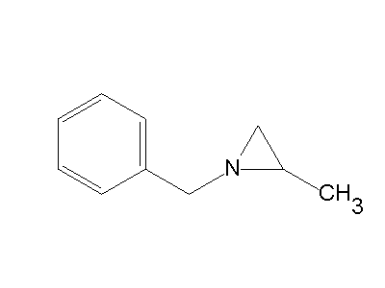
Making our starting material: 2-methyl-1-phenylaziridine
Original Protocol:
250 mL THF
2.3 mL N-benzyl-2-methylaziridine
20.6 mL Butyl Lithium
Stir 30 minutes at 0°C under argon atmosphere
3.57 mL Benzylbromide at -78°C
Stir for 1 hour at 0°C
workup with ammonium chloride solution, then ether/water extraction and rotary evaporated

Slide 4
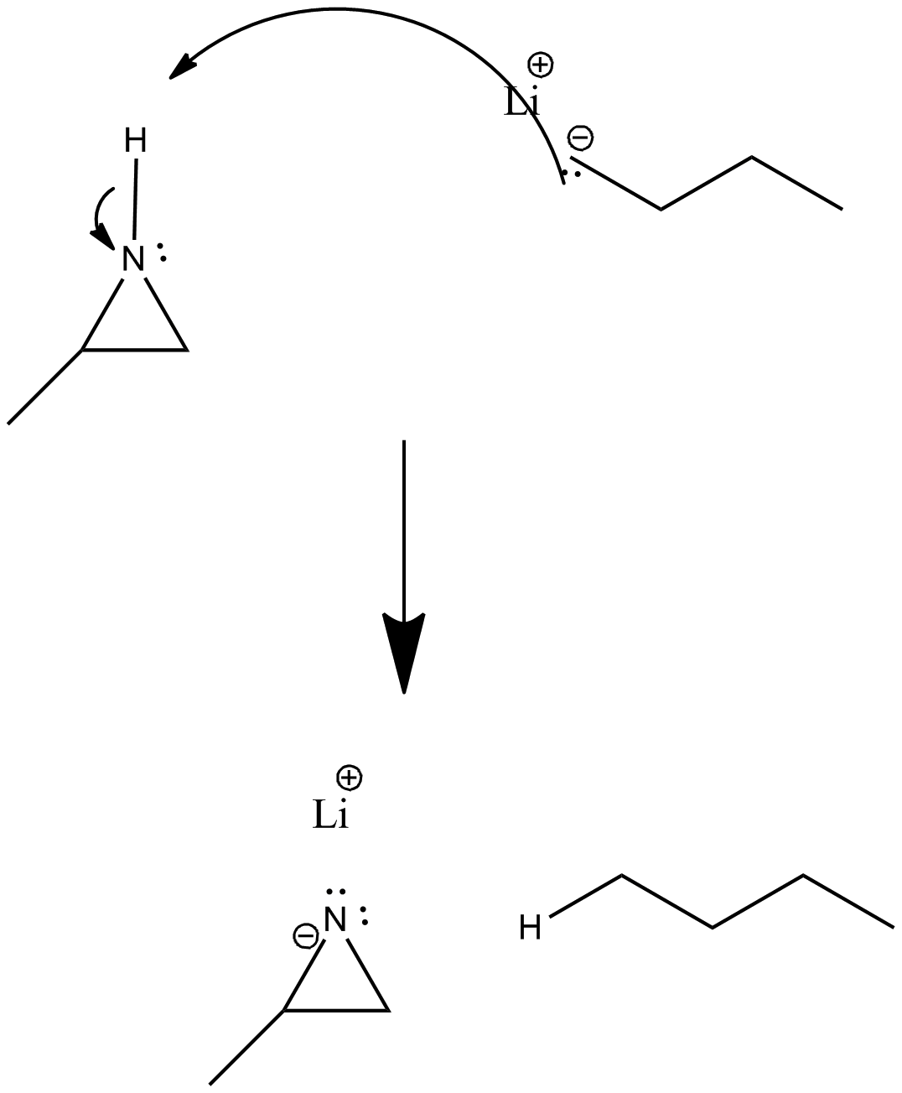
Mechanism

Slide 6
Results: Aziridine with impurities

Slide 7
Problem:
N-benzyl-2-methylaziridine was only 90% aziridine, not 100%
Excess butyllithium and benzyl bromide
Reacted in many ways, caused many impurities in product
Solution:
Re-work protocol to achieve proper ratios of reactants
Should avoid reaction of excess butyl lithium with benzyl bromide

Slide 8
Chau’s Protocol:
50 mL THF
0.4125 N-methyl aziridine
Used instead of 0.575 mL in ¼ Rxn
2.8125 mL BuLi
0.3325 mL Benzyl Bromide

Slide 9
Complications: THF
THF from Dr. Mack’s Lab
Not successful for any group
Aziridine made, not pure
Not successful with Chau’s Protocol
THF from Dr. Guan’s Lab
Works with Chau’s Protocol
Results range from somewhat pure to very pure

Slide 10
Aziridine with Dr. Mack’s THF

Slide 11
Aziridine with Dr. Guan’s THF

Slide 12
Chau’s Protocol or the THF?
Chau’s protocol removed the extraneous side reactions
Dr. Guan’s THF removed general impurities and allowed greater yields

Slide 13
Other Complications
Dropping of Benzyl Bromide
Too fast
Accidental non-argon atmosphere
Causes THF to react with atmosphere
THF not cold enough
Human error
Need for an automatic pipette
Stir Bars are important

Slide 14
When to work-up
Best results: Same day or early the following day
Bad results: 2 or more days after initial experiment

Slide 15
Possible dimers

Slide 16
Further work
We now have a protocol for synthesis of nearly pure 2-methyl-1-phenylaziridine in quantitative yield
Reactions with…
carbon dioxide
benzaldehyde
p-nitrobenzaldehyde
iminium ion

Slide 17
Starting material: carbon dioxide
Mechanism
“The Solvent-free and Catalyst-free Conversion of an Aziridine to an Oxazolidinone Using Only Carbon Dioxide” Phung, C.; Ulrich, R. M.; Ibrahim, M.; Tighe, N. T. G.; Lieberman, D. L.; Pinhas, A. R. Green Chem. 2011, 13, 3224-3229.

Slide 18
Aziridine used in oxazolidinone synthesis
Aziridine
Impurity (MW = 210)

Slide 19
Synthesis 1
Protocol: Packed with dry ice (CO2) and put in HSBM for 999 minutes
Results: Peak at 10 minutes, so still good amount of unreacted aziridine
Impurity still present just before 15 mintues
Small peak for oxazolidinone at 191
Putting in the ball mill for longer might lead to better yield

Slide 20
Unreacted aziridine
Impurity (MW = 210)
Oxazolidinone

Slide 21
Synthesis 2
Protocol: Packed with dry ice (CO2) and lithium iodide (LiI) catalyst and put in HSBM for 999 minutes
Results: Large oxazolidinone peak at about 17 minutes at 191
Impurity peak for aziridine still present at just before 15 minutes
Other small peaks showing impurities

Slide 22
Impurity (MW = 210)
Oxazolidinone

Slide 23
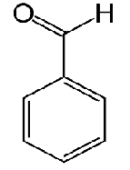
Starting material: benzaldehyde
Expected result:
benzaldehyde
106g/mol
253g/mol

Slide 24
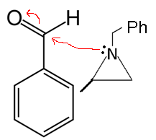
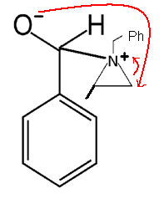
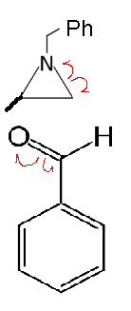
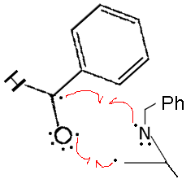
Starting material: benzaldehyde
Possible mechanisms
1.
2.

Slide 25
Syntheses 1 & 2: With and without a catalyst
Protocol:
put in HSBM for 999 minutes
Reactant | Molecular Weight | Amount Used
Aziridine | 147g/mol | 0.045g
Benzaldehyde | 106g/mol | 0.033g
Lithium Iodide Catalyst | 134g/mol | 0.04g

Slide 26
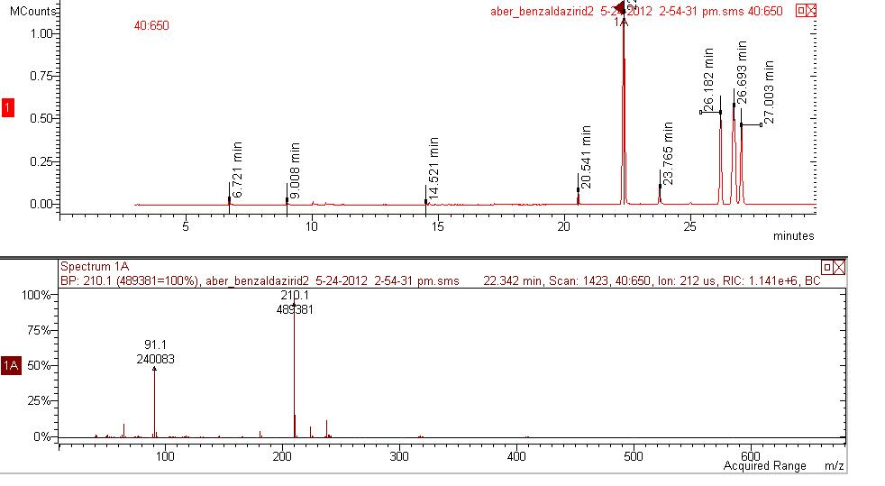
Without a catalyst
unreacted benzaldehyde
unknown impurity
unreacted aziridine

Slide 27
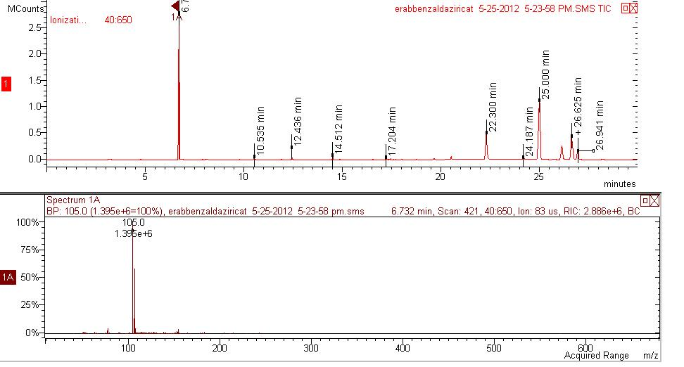
With a catalyst
unreacted benzaldehyde
unknown impurities
unreacted aziridine

Slide 28
Conclusions
Improvements:
Use more reactants to derive more product to allow for further testing (ie HNMR)
Purer aziridine
Further Investigations:
Discover the identity of the 210 impurity and the cause of the 3 unknown peaks
More trials in trying to react Aziridine and Benzaldehyde, including the use of different catalysts

Slide 29
Starting material: p-nitrobenzaldehyde
Mechanism
p-nitrobenzaldehyde
expected product

Slide 30
Synthesis 1 Without a catalyst
Protocol: Added 0.5091g p-nitrobenzaldehyde and 0.4956 aziridine to ball bearing with ~0.5 wet THF, and put in HSBM for 999 minutes
Results: No reaction
peak at 147 for aziridine
peak at 150 for p-nitrobenzaldehyde (lost a proton)
unknown peak at 182 from starting material

Slide 31
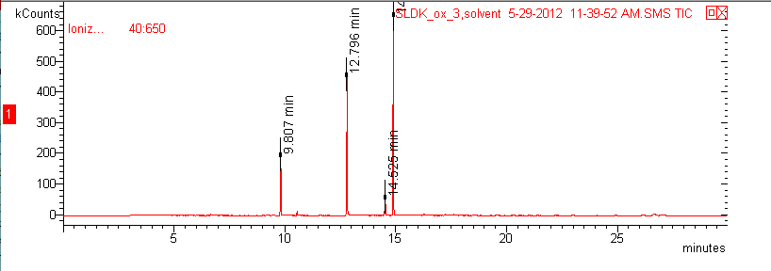
aziridine at 147
unknown peak at 182 (from starting material)
p-nitrobenzaldehyde at 150

Slide 32
Synthesis 1 With a catalyst: ammonium iodide
Protocol: Added a spatula-full of ammonium iodide (NH₄I) to same ball bearing, and put in HSBM for 999 minutes
Results: No reaction
peak at 147 for aziridine
peak at 150 for p-nitrobenzaldehyde (lost a proton)
unknown peak at 182 from starting material

Slide 33
Synthesis 1 With a catalyst: lithium iodide
Protocol: Added a spatula-full of lithium iodide (LiI) to same ball bearing, and put in HSBM for 999 minutes
Results: No reaction
peak at 147 for aziridine
peak at 150 for p-nitrobenzaldehyde (lost a proton)
unknown peak at 182 from starting material

Slide 34
Synthesis 2 With a catalyst + solvent
Protocol: Added 0.45g aziridine, 0.47g p-nitrobenzaldehyde, ~0.4g lithium iodide, and ~0.5mL dry THF into ball bearing, and put in HSBM for 999 minutes
Results: No reaction
peak at 147 for aziridine
peak at 150 for p-nitrobenzaldehyde (lost a proton)
unknown peak at 182 from starting material

Slide 35
Synthesis 2 With a catalyst + no solvent
Protocol: Added 0.45g aziridine, 0.47g p-nitrobenzaldehyde, and ~0.4g lithium iodide into ball bearing, and put in HSBM for 999 minutes
Results: Possible reaction-inconclusive
peak at 147 for aziridine
no peak at 150 for p-nitrobenzaldehyde
unknown peak at 182 from starting material
2 additional peaks

Slide 36
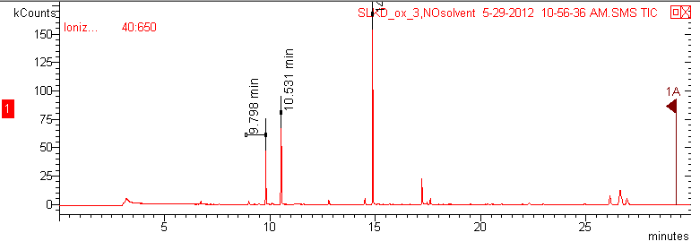
unknown peak
aziridine at 147
unknown peak at 182 (from starting material)
unknown peak

Slide 37
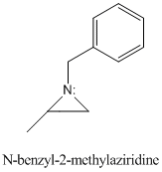
Starting material: iminium ion
Formation of 1,2-diamine

Slide 38
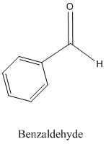
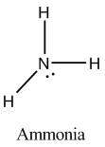
Protocol
Compound | Amount | Purpose
N-benzyl-2-methylaziridine | 0.9 g | Reagent
Benzaldehyde | 0.56 mL | Reagent
Ammonia (gas) | Excess | Reagent
Ammonium bromide | 56 mg | Reagent/acidic conditions
Absolute ethanol | 3.2 mL | Solvent

Slide 39
Added 0.56 mL of benzaldehyde to 3.2 mL of absolute ethanol in a 50 mL round bottom flask
Added 56 mg of ammonium bromide to the solution to create acidic conditions and stir for 5 minutes
Iminium formation only occurs under acidic conditions. Ammonium bromide used instead of HCl solution because iminium reacts with water
Added 0.9 g of N-benzyl-2-methylaziridine to flask
Stirred solution for 3 minutes
Bubbled ammonia gas through solution to saturate
Mixture heated, then cooled. Total time approximately 5-10 minutes
Protected mixture from exposure to light and allow to sit for one week
Removed solvent via rotary evaporator
Add 6M NaOH to solution until pH reaches 11 or higher
pKa of amine groups in expected product are 8-10, so basic conditions are necessary to ensure they are not protonated to make ammonium ions
Ammonium ions are soluble in water, while amines are soluble in ether
Added amount of ether approximately equivalent to amount of 6M NaOH added
Extracted ether layer, dry with potassium carbonate

Slide 40
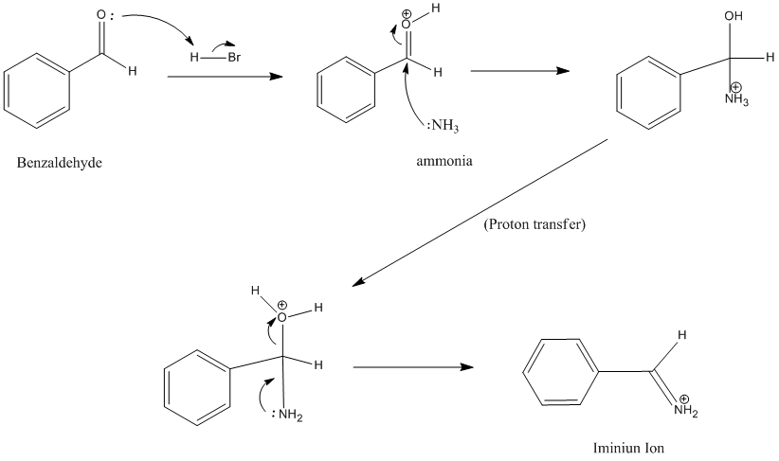
Mechanism

Slide 41
Mechanism

Slide 42
Results – Mass Spec
Compound/ion | Molecular Weight
1,2-diamine | 164
Benzaldehyde | 105
N-benzyl-2-methylaziridine | 147
Ammonia | 17
Absolute ethanol | 46
Benzyl | 91
Desired product
Product fragments
91
134
30

Slide 43
Results – Mass Spec
107 - ?
135 - ?
79 - ?
136 - ?
No 91?
105 - benzaldehyde

Slide 44
Results - HNMR
multiplet, 7-8
Multiplet, 2.0-2.5
Variable/Multiplet, 0.5-5
Multiplet, 2.0-2.5
Quartet, 2.0-2.5
Doublet, 1-1.5

Slide 45
Results - HNMR
Shift | Splitting
1-1.5 | doublet
2-2.5 | Multiplet (3)
7-8 | multiplet
0.5-5 | Variable (N-H)
1-1.5 doublet?
7-8 multiplet?
2-2.5 Multiplet?
benzaldehyde?
Variable (N-H)?
???

Slide 46
Conclusions
Final product is unknown
No apparent benzyl group in product, according to Mass Spec
Observed fragments do not match molecular weight of any expected fragments
HNMR splitting patterns and shifts unclear
Possible errors
Contaminated starting materials – aziridine combined from two different batches
Possibly contaminated 6M NaOH solution
Further research
Use single sample of aziridine starting material
Stir sample for one week before working up, rather than sitting

