Slide 1
Ch. 9 Transformational Leadership
Honors Leadership Seminar
Nick Herrmann

Slide 2
Summary of Transformational Leadership
Inspiring followers to accomplish great things
Foci
Trust
Morals
Motivation/Inspiration
Challenge
Vision
Leadership beyond exchange
Usually measured with MLQ

Slide 3
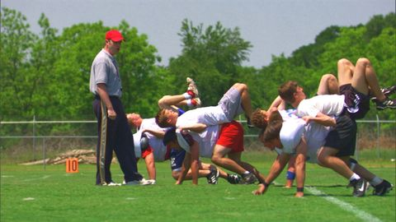
Facing the Giants: deathcrawl clip
http://www.youtube.com/watch?v=T_wyBftd8gk

Slide 4
Connections
Coach
Knew work was required to obtain vision
Knew audience’s motives, uses Brock as vessel to connect to team
Brock’s endurance inspires team
Results go beyond expectations
For team
For Brock
For Coach

Slide 5
Connections cont.
Coach as leader vs. followers
Trust
Respect
Individual consideration
Established goal “for good of team”
Coach seen less as director, more as inspirer

Slide 6
Question 1
Who is the role model here, the coach or Brock?
Is Brock a transformational leader in himself or is the coach the clear-cut leader here?

Slide 7
Question 2
In what types of situations are transformational leadership approaches best? What situations are transactional the best?

Slide 8
Question 3
Whenever someone deals with motivations and morals a lot could go wrong. What are some of the risks involved in transformational leadership? Are risks necessary for exceptional results?

Slide 9
Question 4
How can a group stay inspired by a leader, or does the charisma or novelty of the leader always wear off?

